Slide 1
Pregnancy

Slide 2
Pregnancy
Properties of drugs | Effect on Placenta
Ion-trapping (basic drugs) | Fetal pH is slightly acidic Basic drugs goes into fetus and ionizes Ionized drug stays in fetus
MW < 500 daltons | Low molecular weight passes through palcenta
Low protein binding | Pass through into placenta Pregnant lose protein during 2nd trimester
High lipid solubility | Pass through into placenta
Organ of Mother | Effect | Clinical Relevance
GI | Decrease GI motility | Decrease absorption Delay in effect
Breast | M/P ratio = [milk] / [plasma] | < 10% acceptable 10-25% use with caution > 25% avoid use unless necessary
Heart | Increase cardiac output
Liver | Increase hepatic flow | High extraction ratio drugs are Dependent of hepatic flow
Renal | Increase renal flow
Fluid | Increase water | Delay in effect
Notes:
Low extraction ratio = low amount eliminated (they all passed through liver/kidney)

Slide 3
Pediatric

Slide 4
Pediatrics
Pregnant ------------------ Give Birth ------------- Neonate ------ Infant ------- Toddler ----- Child
30 days 1 year 3 years 11 years
Gestational Age
Chronological Age
Post menstrual age (expressed in weeks) = Gestational + Chronological

Slide 5
Pediatrics PK
Absorption
GI | Decrease GI motility High pH (basic) Decrease absorption of weak acids: Phenobarb and Phenytoin
Liver | Vitamin A and E are difficult to absorb
Distribution
Body of water | Extracellular water
Protein Binding | Decreased albumin: Ceftriaxone is used in adults Cefotaxime is used in infants b/c it has less protein binding
Metabolism
Phase 1: CYP | Neonate: Low CYP Children: Increase in CYP 1A2: theophylline + CH3 = Caffeine
Phase 2: UGT, NAT | Low Glucuronidation Chloramphenicol: Grey baby syndrome Morphine: can NOT metabolize to active metabolite (need higher dose) Benzyl alcohol (preservative): avoid
Elimination
Renal | Monitor Neonate urine output: normal > 1 mg/kg/hr

Slide 6
Geriatrics

Slide 7
Geriatrics: PK
Absorption | Rate of absorption may be delayed but NOT extent of absorption
GI | Delayed gastric emptying Decreased GI blood flow
Skin, Muscle | Decreased blood flow
Distribution
Body of water | Low Vd
Muscle | Low lean body mass
Fat | High body fat. Diazepam t1/2 in adults 24 hours Diazepam t1/2 in elderly > 90 hours
Metabolism
Hepatic | Decrease blood flow BZP: Lorazepam (Ativan), Oxazepam (Serax), Temazepam (Restoril) LOT of BZP
Elimination
Renal | May overestimate b/c of lean muscle mass

Slide 8
Geriatrics: PD
Pharmacodynamic
CV | Increase Catecholamine → Downregulation of receptors Beta blockers have blunted effect
Baroreceptor | Difficult to react
BBB | Decreased permeability
Cholinergic neurons | Decrease cholinergic neurons = Sensitive to anti-cholinergic H1 TCA

Slide 9
Obesity

Slide 10
Obesity: PK
PK
Absorption | No significant effect
Distribution | Lipid soluble drugs = Higher Vd than normal person Hydrophilic drugs = same as normal person
Metabolism | Not well understood
Elimination | Increase Kidney size = Increase Renal Elimination
PK After Bariatric Surgery
Smaller stomach | Increase in pH = decrease absorption of acidic meds Rifampin Digoxin Ketoconazole
Intestinal diversion | Limit bile acid resins = reduce bioavailability of lipophilic drugs Rifampin Phenytoin Levothyroxine
Drug | Reason | Recommendation
Calcium | Absorption | Calcium Citrate (not carbonate b/c it requires acid)
Iron | Absorption | Iron + Vit C (make more acidic)
Vit B12 | Stomach can’t produce | B12 injection monthly
Vitamin | Needs multivitamin | Multivitamin daily

Slide 11
Liver Disease

Slide 12
Liver Disease
PK | Result | Clinically
Absorption | Bioavailability Increase b/c bad first pass Rate of absorption decrease | Lower dose if metabolized by liver
Distribution | Hydrophilic drugs: Increase Vd b/c ascites
Metabolism | Decrease Liver blood flow Increase Fraction unbound b/c no protein High ER: Higher peak AND slower elim ex: Lidocaine, morphine, TCA Lower ER: Same Peak BUT slower elim ex: phenytoin, warfarin, theophylline | Decrease dose Less frequent dosing

Slide 13
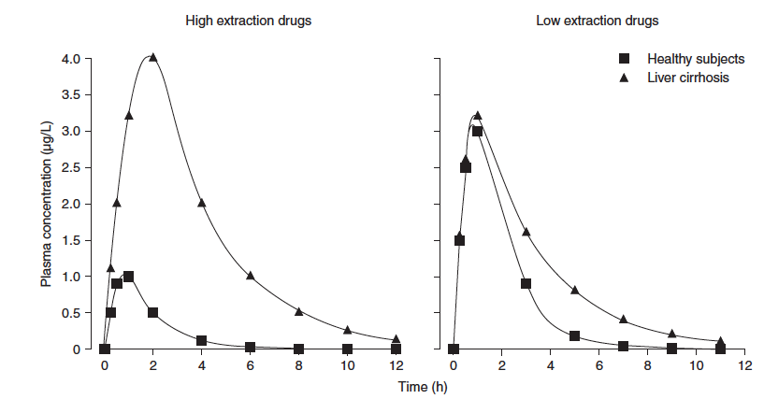
Liver Disease Metabolism
High ER:
Normal liver extracts a lot drug to elim
→ low peak
Cirrhotic liver can’t extract to elim
→ high peak
Solution: lower dose
Low ER:
Normal liver lets drug pass through
→ same peak
Cirrhotic liver lets drug pass through
→ same peak, but slower elim
Solution: Less frequency

